Slide 1
Preservation Cafe: Money-Saving Preventative Home Maintenance
Preservation Cafe: Money-Saving Preventative Home Maintenance
Capitol Hill Restoration Society

Slide 2
Outline of Tonight’s Discussion: Preservation Cafe: Money-Saving Preventative Home Maintenance
Background
Gary’s Background
Background on Tonight’s Discussion
Preventative Measures
Conduct a maintenance inspection
Conclusion & Questions
Conclusions
Take-Aways and Add-ons
Task description
Hand outs
Know the facts about your house before an emergency
Seal up the exterior walls
Clean up your plumbing systems

Slide 3
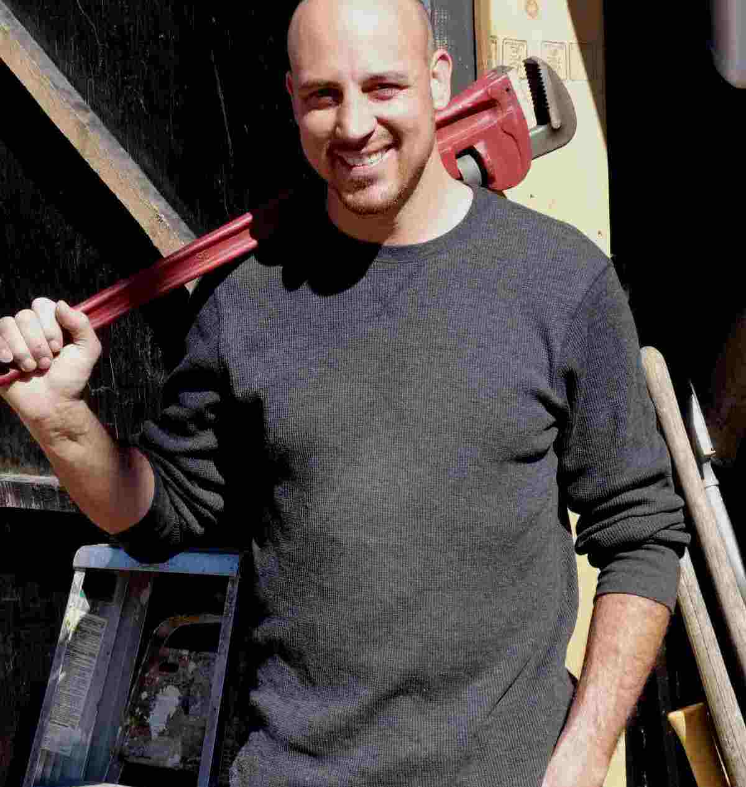
Gary’s Background Preservation Cafe: Money-Saving Preventative Home Maintenance Gary has worn a lot of hats in his 17+ years working in the construction business:
Laborer
Carpenter
Estimator
Superintendent
MEP Specialist
Commercial High Rise Construction
Residential Construction
Project Manager
Quality Control Manager
Contractor
Builder
Inspector
Consultant

Slide 4
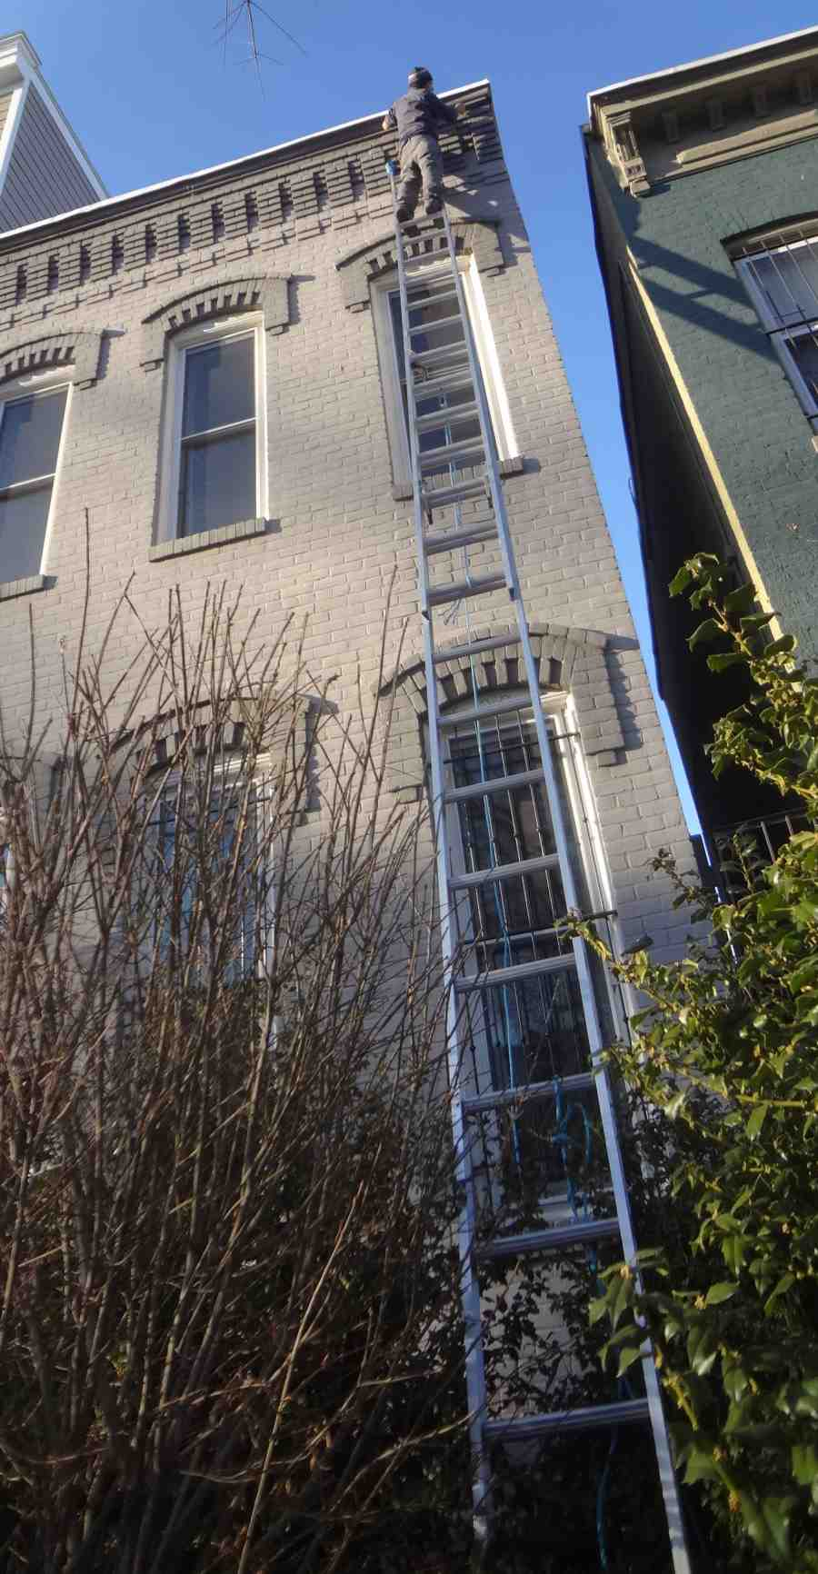
Background on Tonight’s Discussion Preservation Cafe: Money-Saving Preventative Home Maintenance A few important points:
It is less expensive overall to maintain a facility in an ongoing routine then all at once. There is a point of optimality.
DIY vs. Pro: A lot of this can be done by DIY’ers, but sometimes its worth it to call a pro.
Inspecting your house and systems helps you make the best choices for your home.
Proactively managing the information on your house can save significant time and headaches.

Slide 5
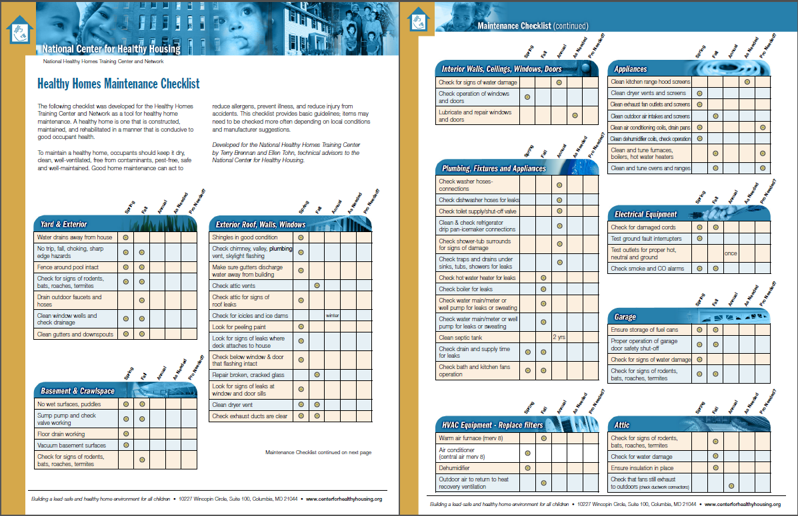
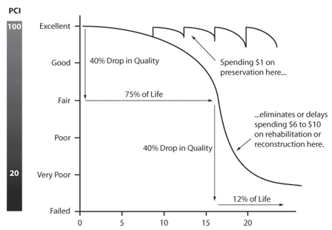
Tonight’s hand outs:
Seasonal inspection checklist
Fed DOT Degradation Curve
DIY versus Pro decision flow chart

Slide 6
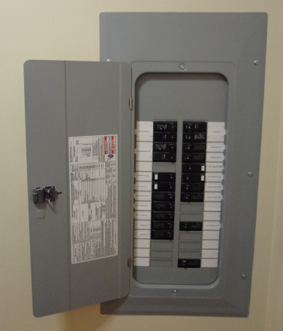
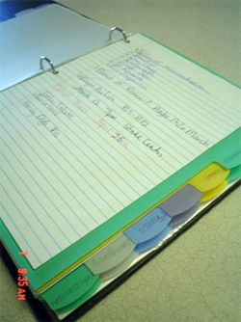
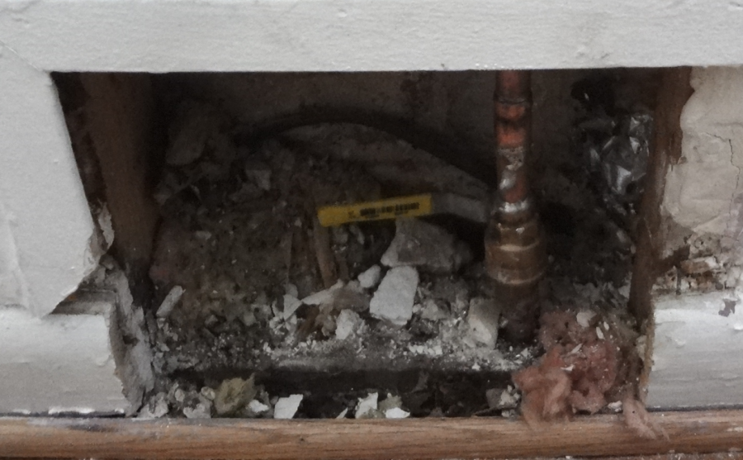
Know the facts on your home Preservation Cafe: Money-Saving Preventative Home Maintenance
Know the facts about your house before an emergency happens. Make sure you know the locations of:
Main water shut off valve
Gas main
Clean outs
Electrical distribution panels
Keep and Maintain a House File that Includes
Appliance serial and model numbers
Info on companies who last serviced equipment
Key codes
Paint codes and sheens
Blueprints on the original and previous construction
Warranties, titles & deeds
Roof membrane material description & manufacturer
Product & owner’s manuals on hand

Slide 7
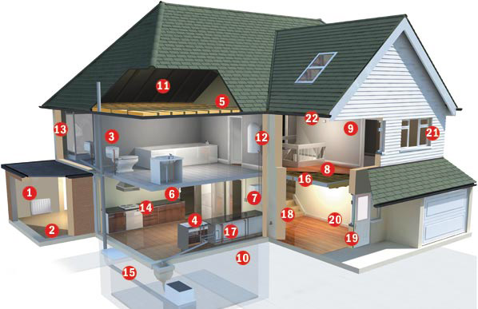
Establish a regular maintenance and inspection schedule for your home Preservation Cafe: Money-Saving Preventative Home Maintenance
Test your sump pump and make sure the discharge line is not obstructed.
Test smoke detectors, test GFCI’s with a GFCI tester, AFCI’s with AFCI tester.
Test your AC overflow shut off float switch.
Clean out debris from gutters to prevent leaks into house.
Clean out area way and patio drains.
Clean out air filters.
Check under angle stops and P-traps for evidence of drips.
Seasonal Checks: Test Furnace in late Summer, not in Fall. Check the condensate drain in the Fall. Prune trees in Winter, not Fall (to avoid decay fungi).

Slide 8
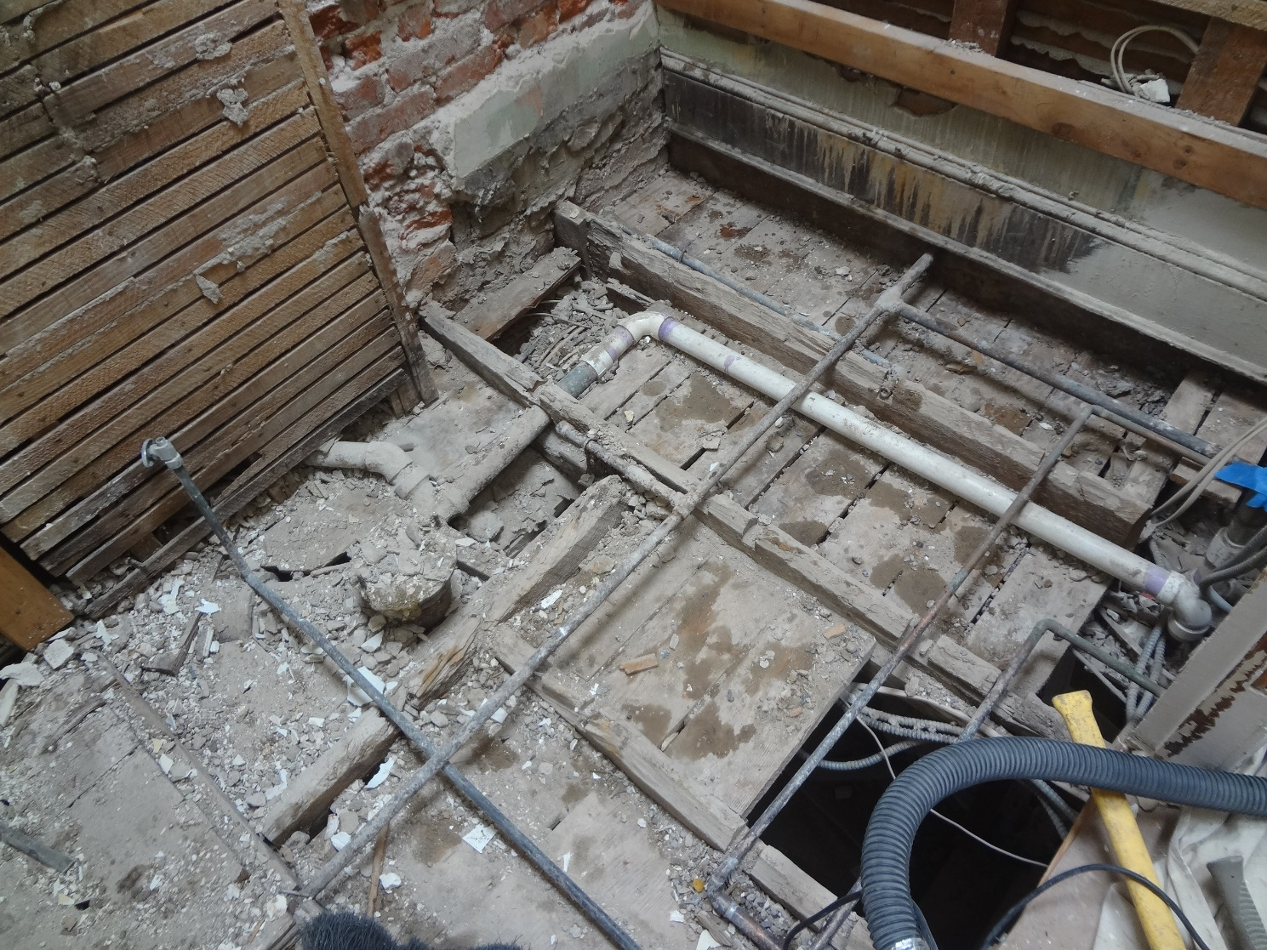
Clean up your Plumbing Systems Preservation Cafe: Money-Saving Preventative Home Maintenance
Drain out the water heater at least once a year.
Check the toilet for internal leaks, change the flapper.
Clean out your aerators, you’d be surprised what you find.
Put good insulation between the exterior wall and your pipes; last winter was rough.
Cut off supply lines to exterior spigots before winter.
Don’t use liquid drain cleaners.

Slide 9
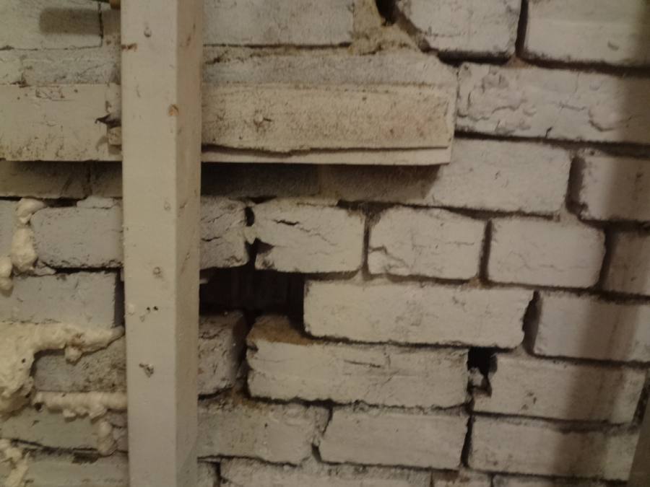
Seal up the exterior walls of your house Preservation Cafe: Money-Saving Preventative Home Maintenance
Weather strip windows and door.
Check cellulose / batt insulation in crawl space and attic. Install more if needed. This provides the LARGEST RETURN ON INVESTMENT.
Install heat trace on pipes in they are in the “line of fire.”
Seal around recessed lights.
Check dampers seal properly.
Inspect the roof annually, apply spot repairs where needed.
Tuck point brick facades on a 25+ yr schedule.
Caulk exterior penetrations for power and water.
Keep a good coat of paint on exterior trim.

Slide 10
Concluding Points
Preventative Maintenance is Cheaper then Reactive Maintenance
There is a right time and a wrong time to invest in a fix up. Too early can be just as much of a waste as too late, optimality is the goal. Education is a lot cheaper than reactive repairs and inspections along the way keep a check on things before its get out of hand.
A DIY Approach goes a long way, but sometimes a pro is worth the cost.
With the internet today, there is almost unlimited info out there so your time and patience are the only limits to the possible extent of DIY solutions. But it is always good to have a good pro on call when you need him / her.
THE 1% RULE
When you consider the life cycle of every component of a house, a reasonable annual estimate of the cost of normal maintenance is 1% of the value of the house. One year you may replace the furnace; a few years down the road you may re-surface the roof. Throw in the odd unexpected repair in between and you average 1% per year. It’s incredible but this rule is not far off, both for very expensive and very inexpensive houses.
Thanks to Ebenezer’s and the Cap Hill Restoration Society!!

